Slide 1
Drawings as a window into shared meaning
Molly Lewis
Lupyan Lab Meeting, 12 October 2017
Notes:
Potential, What are the most interesting questions these data can answer; how to frame it

Slide 2
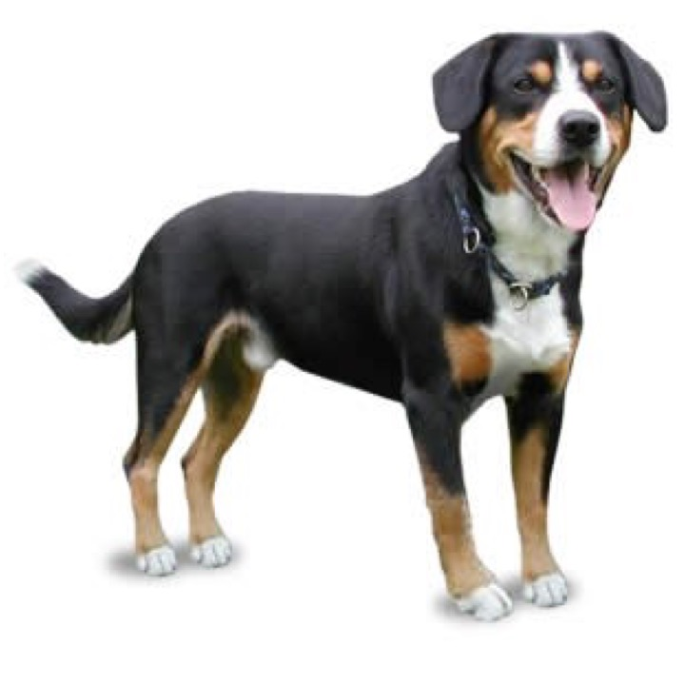
Assumptions about meaning
dog
Shared by members within same community
Varies across communities
Converges through interaction
But lots we don’t know:
How much variability is there across communities?
What kinds of meanings vary most?
What are the processes by which communities converge on meaning?
What predicts variability across cultures?
Notes:
Trivial observation
-> this observation demonstrates three sort of founational assumption about to three different claims about meaning
(e.g., frequent vs. infrequent, abstract vs. concrete)?
\In language Y, “dog” prototypically means poodle (Social psychologists talk about “shared social reality”
)
“dog” in language X prototypically means dalmation

Slide 3
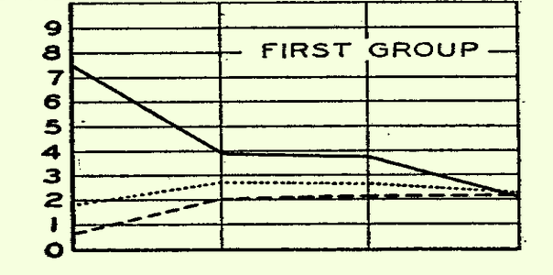
Convergence on shared reality through “conformity”
Sherif’s autokinetic experiment (1935)
Asch’s line experiment (1951)
Distance (inches)
Individually
Group (t1)
Group (t2)
Notes:
A body of literature that’s influence how I think about how meaning emerges is the literature on conformity from social psychology
In particular, 2 Exps – where you ask people in a group to make a judgements about something ambiguous and they converge on the same answer
Scherif: He used the autokinetic effect – this is where a small spot of light (projected onto a screen) in a dark room will appear to move, even though it is still (i.e. it is a visual illusion).
shows the median distance judgement (in inches) for three different subjects. The x-axis plots subjects performance on the task when completed individually, and then three subsequent periods in which the task was completed as a group (of 3 subjects).
It was discovered that when participants were individually tested their estimates on how far the light moved varied considerably (e.g. from 20cm to 80cm).
The participants were then tested in groups of three. Sherif manipulated the composition of the group by putting together two people whose estimate of the light movement when alone was very similar, and one person whose estimate was very different. Each person in the group had to say aloud how far they thought the light had moved.
Asch video: https://www.youtube.com/watch?time_continue=41&v=iRh5qy09nNw
Asch: about one third (32%) conformed

Slide 4
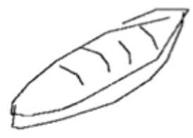
Drawings as a window into meaning
Cognitive representations of meaning difficult to infer from language
v
v
->
“bread” -> ?
…but may be easier from drawings.
Notes:
To the extent that this process of conformity is the same as what happens in language – it’s much harder to study

Slide 5
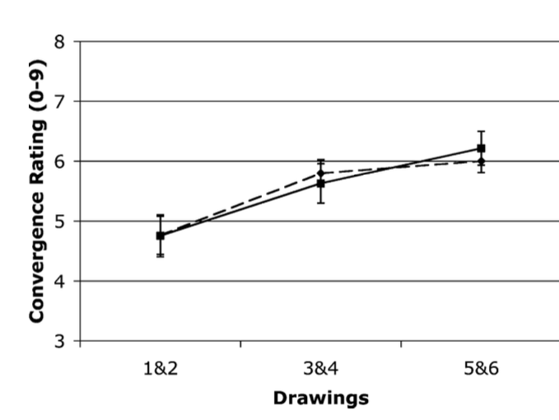
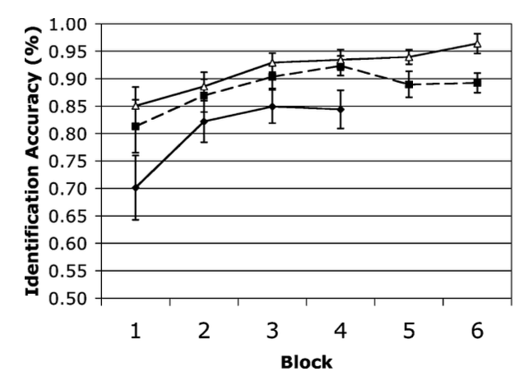
Evidence for convergence in reference (Garrod, et al., 2007)
Pictionary game, manipulating the amount of feedback guesser gives to drawer
How do drawings and accuracy change across repeated interactions?
Feedback
No Feedback
Notes:
The paper that we read is one attempt to look at the process of convergence through social interaction using drawings
Convergence, but not as much acuracy when no feedback (presumably because less convergence)

Slide 6

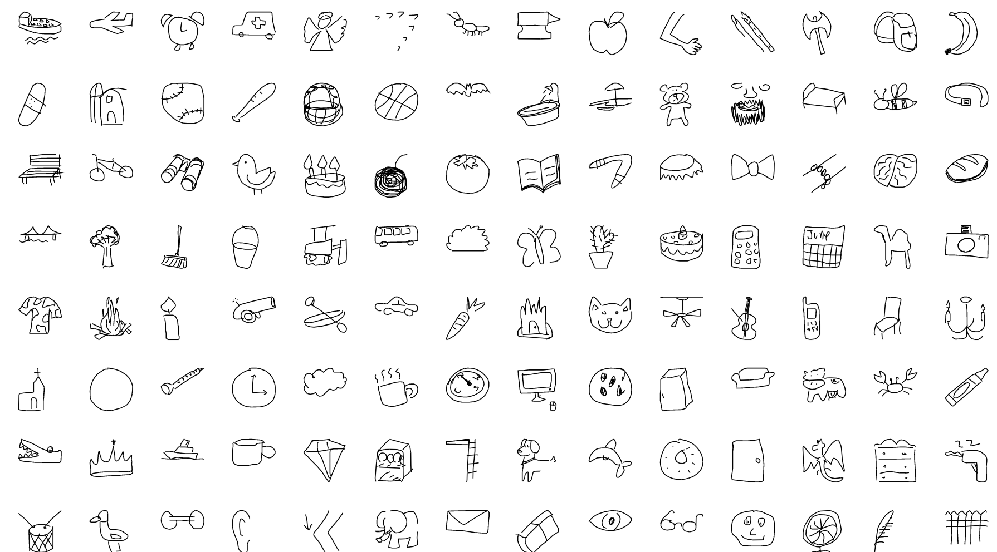
50M drawings across 345 categories (N = 15M) [LINK]
Notes:
So I’ve been trying to get at a related question using this dataset called quickraw
Link: https://quickdraw.withgoogle.com/
file:///Users/mollylewis/Documents/research/Projects/conceptviz/analyses/markdowns/2_drawing_summary_analysis.html

Slide 7
Can we measure within-community convergence?
Two measures of “convergence” (i.e. image similarity):
Hausdorff Distance - image similarity as the minimum Euclidean distance between two sets of points (Huttenlocher, Klanderman, & Rucklidge, 1993)
Internal weights (layer FC2) for drawing from a neural net model trained on ImageNet
similarity = cosine distance on weights between pairs of images.
Notes:
The Hausdorff Distance is commonly used in computer vision
In that field, a typical problem is that you are given an in
not translation, scale and rotation invariant
mage and a model of what you want to match to.
The Hausdorff distance is the longest distance you can be forced to travel by an adversary who chooses a point in one of the two sets, from where you then must travel to the other set. In other words, it is the greatest of all the distances from a point in one set to the closest point in the other set.
maximum distance of a set to the nearest point in the other set
http://cgm.cs.mcgill.ca/~godfried/teaching/cg-projects/98/normand/main.html

Slide 8
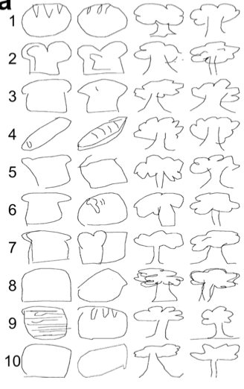
Validating similarity measures with human judgements
1500 image pairs from two categories (“bread” and “tree”) drawn by participants across 72 countries
Selected 20 pairs from each decile of similarity (per item)
Asked participants to rate similarity (1-7 Likert scale)
Each participant (N =100) rated 50 pairs from each category

Slide 9
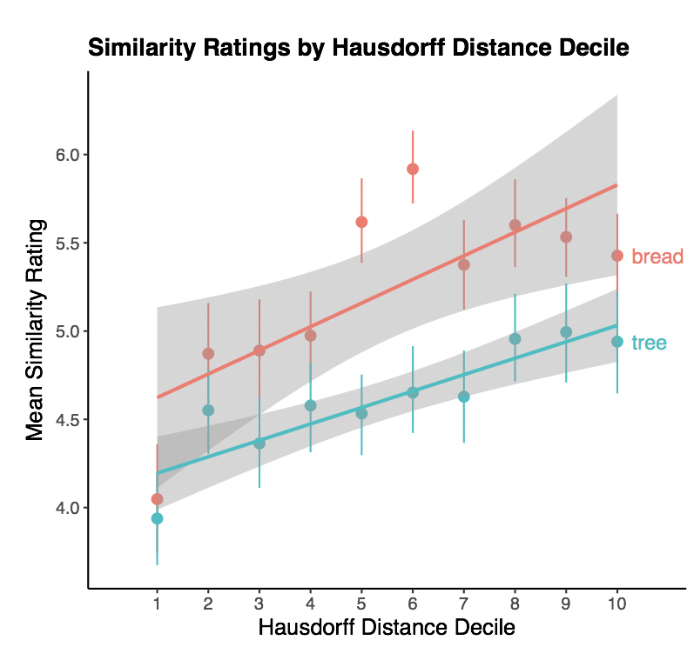
Human similarity results
Correlated with both
Hausdorff Distance (r = .29)
and cosine similarity (r = .2)
N = 100

Slide 10
Cross-cultural variability
Notes:
Item prototypes by country: bread: smallest average pairwise distance to other drawings from the same country.

Slide 11
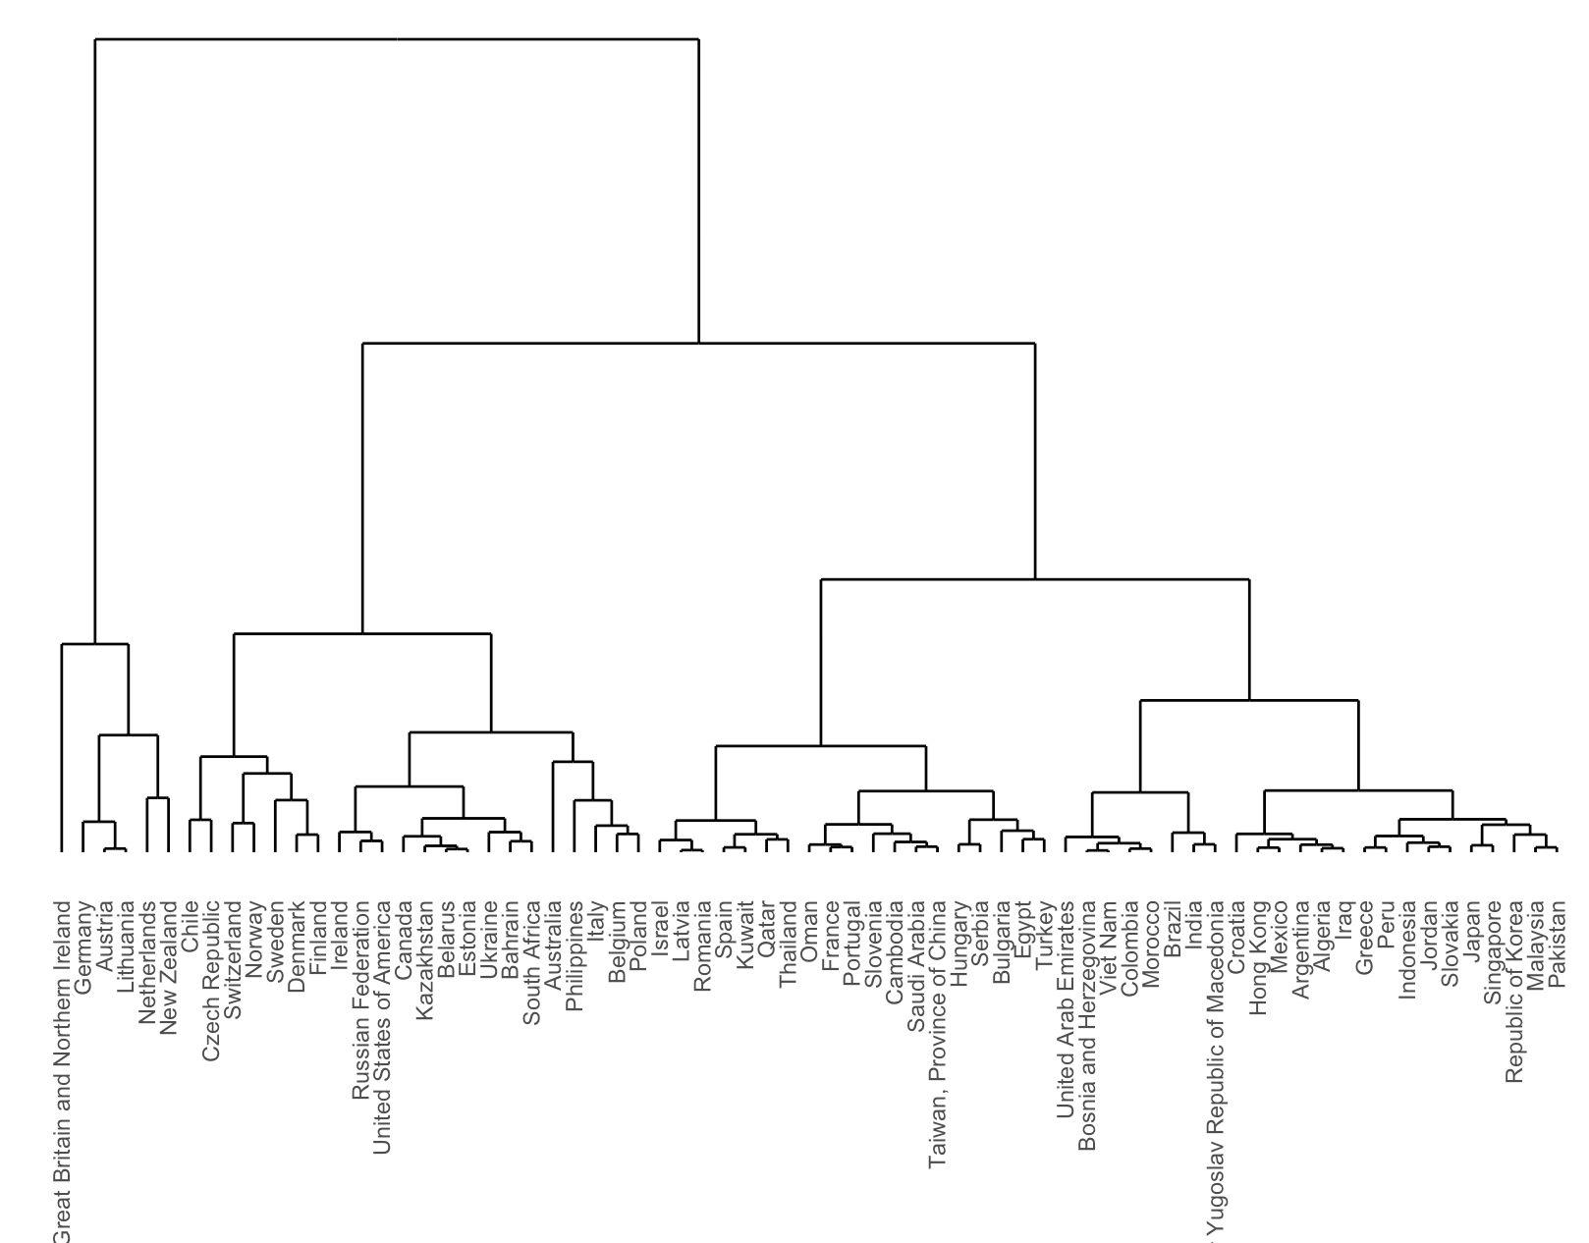
Notes:
For tree – cosine similairites
Grouped by similarity
Hight of cluster -> degree of similarity

Slide 12
Hypothesis: Countries culturally more similar have more similar semantic spaces (→ more similar drawings)
Cultural predictors:
Physical distance: Euclidean distance between centroid of countries
Linguistic distance:
ASJP distance – Overlap in vocabulary
WALS Euclidean distance – Similarity in morphosyntax
Notes:
Can we predict this variability
http://rpubs.com/mll/298572
WALS - compute similarity based on shared WALS features
Trade: http://cow.dss.ucdavis.edu/data-sets/bilateral-trade
Events: https://dataverse.harvard.edu/dataset.xhtml?persistentId=doi:10.7910/DVN/28075
Political: Number of political “events”
Trade: Amount of bilateral trade

Slide 13
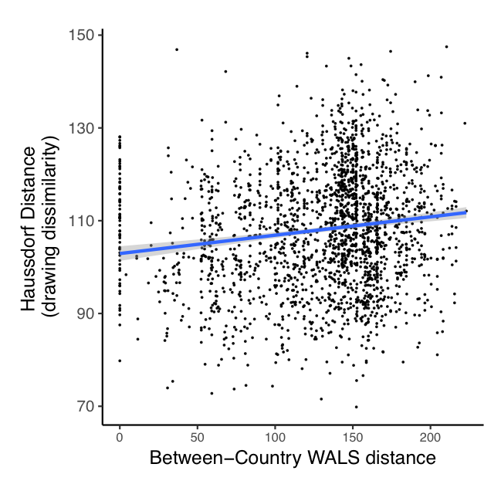
Notes:
Bread
For languages that differed more in terms of their grammar, countries with greater overlap in vocabulary (β = .002; t = 3.27) or smaller geographic distance tended to have more similar drawings (β = -.002; t = -2.17).

Slide 14
Ideas about future directions
X-cultural variability in salience/importance of particular features -> looking at first N strokes
Variability in heterogeneity – can we predict this?
Other predictors of cultural “closeness” – D-place
What are the properties of items that vary more - frequent, less frequent? -> Scale up with more with more items
Is there a way to think about which are more veridical? e.g. top N images in google images search, searching by country
Graphical complexity (Garrod, et al., paper)
Use different layers of neural net – maybe earlier layers?
Neural net trained on drawings

Slide 15
Findings
Abstract words have longer strokes for both English and non-English speakers. Also, difference in accuracy between low and high concreteness words larger for non-english speakers.

